Slide 1
Techniques and Principles

Slide 2
What are Techniques?
Kicks – Front Kick – Lift Knee, Extend, Foot Position
Punches – Reverse Punch – Which Hand – Hips – Hand/Foot Position
Basics – Downwards Block – Which Hand – Stance – Body/ Hand/Foot Position
Kata – Ye Jang – All of the above
Self Defence – Wrist Grab– All of the above

Slide 3
What are Principles?
Base – What touches the floor – Front Stance, Fighting Stance, Ground Defence
Balance – Stances– Kicks – Punches – Blocks – Self Defence
Distance – Between You & Target – Kicks & Punches are different – Comfort Zone/Danger Zone/Cuddle Zone - Running
Time – To Hit the Target– Kicks Punches Blocks different - Running
Structure – Bone is stronger than muscle

Slide 4
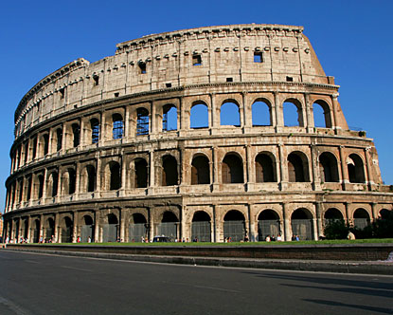
Principles hold up our Techniques
Example: Front Kick
Base is Fighting stance & when kicking – 1 foot on floor
Balance when kicking is over the supporting leg
Distance which F/Kick – Step up/Back Leg/Front Leg
Time How long to kick - split timing/ is there time to kick?
Structure What is the best body position to make the kick the strongest?

Slide 5
Get into pairs and pick a couple of Techniques and work out the principles
No techniques the same ie 2 kicks or 2 punches.

